Slide 1

UNIVERSITY INSTITUTE OF ENGINEERING
DEPARTMENT OF COMPUTER SCIENCE AND ENGG.
Bachelor of Engineering (Computer Science & Engineering)
DATA STRUCTURES
TREES
DISCOVER . LEARN . EMPOWER

Slide 2
Tree Traversals
Pre-Order
  N L R
In-Order
  L N R
Post-Order
  L R N

Slide 3
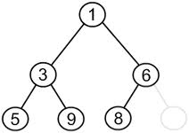
Tree Traversals
Pre-Order(NLR)
1, 3, 5, 9, 6, 8

Slide 4
Tree Traversals
In-Order(LNR)
5, 3, 9, 1, 8, 6

Slide 5
Tree Traversals
Post-Order(LRN)
5, 9, 3, 8, 6, 1

Slide 6
Preoder, Inorder, Postorder
In Preorder, the root
is visited before (pre)
the subtrees traversals
In Inorder, the root is
visited in-between left
and right subtree traversal
In Preorder, the root
is visited after (pre)
the subtrees traversals
Preorder Traversal:
Visit the root
Traverse left subtree
Traverse right subtree
Inorder Traversal:
Traverse left subtree
Visit the root
Traverse right subtree
Postorder Traversal:
Traverse left subtree
Traverse right subtree
Visit the root

Slide 7
Illustrations for Traversals
Assume: visiting a node
is printing its label
Preorder:
1 3 5 4 6 7 8 9 10 11 12
Inorder:
4 5 6 3 1 8 7 9 11 10 12
Postorder:
4 6 5 3 8 11 12 10 9 7 1
1
3
7
5
8
9
10
4
6
11
12

Slide 8
Illustrations for Traversals (Contd.)
Assume: visiting a node
is printing its data
Preorder: 15 8 2 6 3 7
11 10 12 14 20 27 22 30
Inorder: 2 3 6 7 8 10 11
12 14 15 20 22 27 30
Postorder: 3 7 6 2 10 14
12 11 8 22 30 27 20 15
15
8
20
2
11
27
6
10
12
22
30
3
7
14

Slide 9
Code for the Traversal Techniques
The code for visit
is up to you to
provide, depending
on the application
A typical example
for visit(…) is to
print out the data
part of its input
node
void preOrder(Tree *tree){
if (tree->isEmpty( )) return;
visit(tree->getRoot( ));
preOrder(tree->getLeftSubtree());
preOrder(tree->getRightSubtree());
}
void inOrder(Tree *tree){
if (tree->isEmpty( )) return;
inOrder(tree->getLeftSubtree( ));
visit(tree->getRoot( ));
inOrder(tree->getRightSubtree( ));
}
void postOrder(Tree *tree){
if (tree->isEmpty( )) return;
postOrder(tree->getLeftSubtree( ));
postOrder(tree->getRightSubtree( ));
visit(tree->getRoot( ));
}

Slide 10
Application of Traversal Sorting a BST
Observe the output of the inorder traversal of the BST example two slides earlier
It is sorted
This is no coincidence
As a general rule, if you output the keys (data) of the nodes of a BST using inorder traversal, the data comes out sorted in increasing order

Slide 11
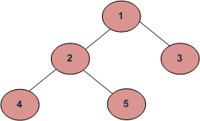
Example 1 of Tree Traversal
Depth First Traversals:
(a) Inorder (Left, Root, Right) : 4 2 5 1 3
(b) Preorder (Root, Left, Right) : 1 2 4 5 3
(c) Postorder (Left, Right, Root) : 4 5 2 3 1

Slide 12
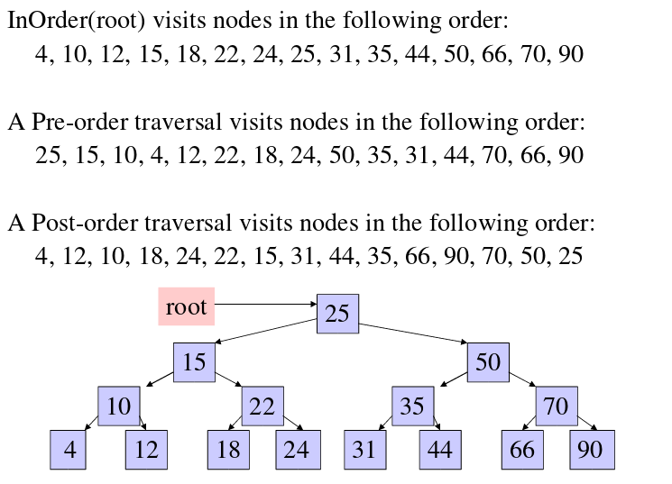
Example 2

Slide 13
Algorithm: Preorder traversal using stacks
Preorder Traversal: PREORD(INFO, LEFT, RIGHT, ROOT) : A binary tree T is in memory. The algorithm does a preorder traversal of T, applying an operation PROCESS to each of its nodes. An array STACK is used to temporarily hold the addresses of nodes.
[initially push NULL onto STACK & initialize PTR]
Set TOP=1, Stack[1]=NULL & PTR=ROOT
Repeat steps 3 to 5 while PTR≠NULL :
3. Apply PROCESS to INFO[PTR]
[Right Child?]
If RIGHT[PTR]≠NULL, then: [push on stack]
Set TOP=TOP+1 and
STACK[TOP]=RIGHT[PTR]
[End of if structure]
[Left child?]
If LEFT[PTR] ≠ NULL, then:
Set PTR=LEFT[PTR]
Else: [POP from stack]
Set PTR=STACK[TOP] & TOP=TOP-1
[End of If structure]
[End of step2 loop]
6. Exit

Slide 14
Algorithm: In order traversal using stacks
Inorder Traversal: INORD(INFO, LEFT, RIGHT, ROOT) : A binary tree T is in memory. The algorithm does a inorder traversal of T, applying an operation PROCESS to each of its nodes. An array STACK is used to temporarily hold the addresses of nodes.
[initially push NULL onto STACK & initialize PTR]
Set TOP=1, Stack[1]=NULL & PTR=ROOT
Repeat while PTR≠NULL : [pushes left most path onto STACK]
  (a) Set TOP=TOP+1 & STACK[TOP]=PTR [saves node]
(b) Set PTR=LEFT[PTR] [updates PTR]
[End of loop]
Set PTR = STACK[TOP] & TOP=TOP-1 [Pops node from STACK]
Repeat steps 5 to 7 while PTR≠NULL: [Backtracking]
5. Apply PROCESS to INFO[PTR]
6. [Right Child?] If RIGHT[PTR]≠NULL, then:
(a) Set PTR = RIGHT[PTR]
(b) Go to step 2
[End of if structure]
Set PTR = STACK[TOP] & TOP=TOP-1 [Pops node]
[End of step 4 loop]
8. Exit

Slide 15
Algorithm: Post order traversal using stacks
Postorder Traversal: POSTORD(INFO, LEFT, RIGHT, ROOT) : A binary tree T is in memory. The algorithm does a postorder traversal of T, applying an operation PROCESS to each of its nodes. An array STACK is used to temporarily hold the addresses of nodes.
[initially push NULL onto STACK & initialize PTR]
Set TOP=1, Stack[1]=NULL & PTR=ROOT
[push left-most path onto Stack]
Repeat steps 3 to 5 while PTR≠NULL:
Set TOP=Top+1 & STACK[TOP]=PTR
[Pushes PTR on STACK]
If RIGHT[PTR] ≠ NULL , then : [push on stack]
Set TOP=TOP+1 & STACK[TOP] = -RIGHT[PTR]
[End of if structure]
Set PTR = LEFT[PTR] [updates pointer PTR]
[End of step 2 loop]
Set PTR = STACK[TOP] & TOP=TOP-1
[pops node from Stack]
Repeat while PTR>0:
(a) Apply PROCESS to INFO[PTR]
(b) Set PTR = STACK[TOP] & TOP=TOP-1
[pops node from STACK]
[end of loop]
If PTR<0, then:
(a) Set PTR=-PTR
(b) Goto step2.
[End of if structure]
9. Exit

Slide 16
References
Li`pschutz, Seymour, “Data Structures”, Schaum's Outline Series, Tata McGraw Hill.
Data structure and algorithm by Narasimha Karumanchi.
www.tutorialspoint.com
www.geeksforgeeks.com
16

Slide 17
Books Recommended
Goodrich, Michael T., Tamassia, Roberto, and Mount, David M., “Data Structures and Algorithms in C++”, Wiley Student Edition.
Aho, Alfred V., Ullman, Jeffrey D., Hopcroft ,John E. “Data Structures and Algorithms”, Addison Wesley
Lipschutz, Seymour, “Data Structures”, Schaum's Outline Series, Tata McGraw Hill.
Gilberg/Forouzan,” Data Structure with C ,Cengage Learning.
Augenstein,Moshe J , Tanenbaum, Aaron M, “Data Structures using C and C++”, Prentice Hall of India

Slide 18
THANK YOU

